Slide 1
3D Design and Solid Modelling
Week 1
  City & Guilds course running for 2 terms
  Assessment
    2 practical assignments
      Faces
      Solids
    1 multiple choice
    1 log book
      Put in a file
      Bring each week
      Each evening I will on the board which sections we have covered
      Sign and date your log book accordingly
  Save and date your drawings
    Save printed copies in your file
    Save electronic copies in your college account

Slide 2
City & Guilds
Is there a formal exam?
  No, complete practical assignments any evening, retake any time
Will I see the paper in advance?
  Yes, for the practicals. No for the multiple choice
How good do I need to be at AutoCAD right now?
  Complete 2D drawing of front of pump body including layers, linetypes etc in 30 minutes (first time)
How long is the term?
  13 week. 6 week then half term then another seven weeks.
  6 to 9pm. Teaching starts at 6.30pm.
Target – to complete solid modelling by the end of term
  Remember you have to complete the views of the model as well as just create the model.
Recommended book
  Modelling with AutoCAD 2002 by Bob McFarlane pub Butterworth Heinmann.

Slide 3
3D AutoCAD
3D modelling – 2 types
  Surfaces
    Points, lines, faces
    Hidden line removal possible
    No mass properties
    Meshes
  Solids
    Real 3D representation
    Mass properties
    Interference can be highlighted

Slide 4
The Third Dimension
So far all drawings have been in 3D
  Just have not used the third dimension. Z axis comes out towards you.
So far World Co-ordinate System only
  User Co-ordinate System (UCS) available
UCS – start with 2D UCS
  Use UCS.dwg as template drawing (look in S:\mary)
    Save each UCS by name
      Tools, Named UCS
        Call them FIRST, SECOND etc

Slide 5
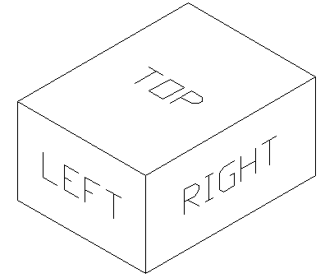
Using UCS in 3D
  Draw, Solids, Box 0,0,0 and 30,40,20
    View, 3D Views, SE Isometric
    View, Hide
  Write TOP on the top of the box
    Tools, New UCS, Origin to corner of the top of the box
    Draw, Text write TOP on the top of the box
    Save this UCS
      Tools, Named UCS
  Write LEFT on left side
    Tools, New UCS, 3 Point
    Draw, Text write LEFT on the left side of the box
    Save this UCS as before
  Continue
    Complete for FRONT, RIGHT, BACK, BOTTOM
  Can rotate viewpoint of object
    View, 3 Orbit
    View, Hide may help
  Note, you can rotate the UCS and then move it.

Slide 6
Individual Work
Draw a dice
  Complete with dots on each face, save it
Follow notes
  Titled ‘3D Solid Models’
Log Book
  Sections completed this time
    1.1.1
    1.2
    3.1.1, 3.1.2 and 3.1.3
    3.2 and 3.4
    4.1.1
    4.2.1, 4.2.2 and 4.2.6

